Slide 1
Tropical IR fluxes
Starting at the surface, no clouds or rain
(Red, Model Alt, is the saved background model run, here the upward IR flux)

Slide 2
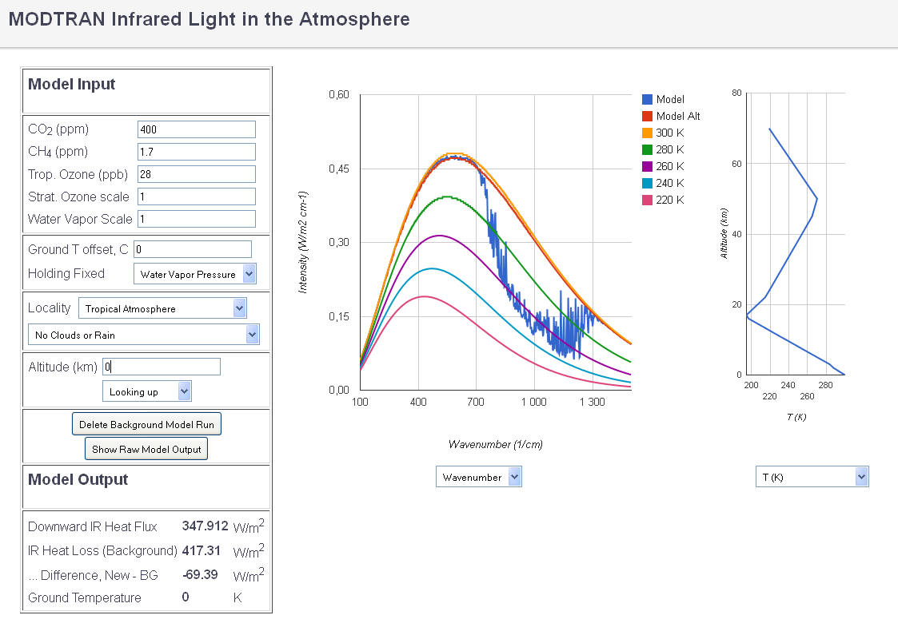
CO2 400 ppm, net loss 69.4

Slide 3
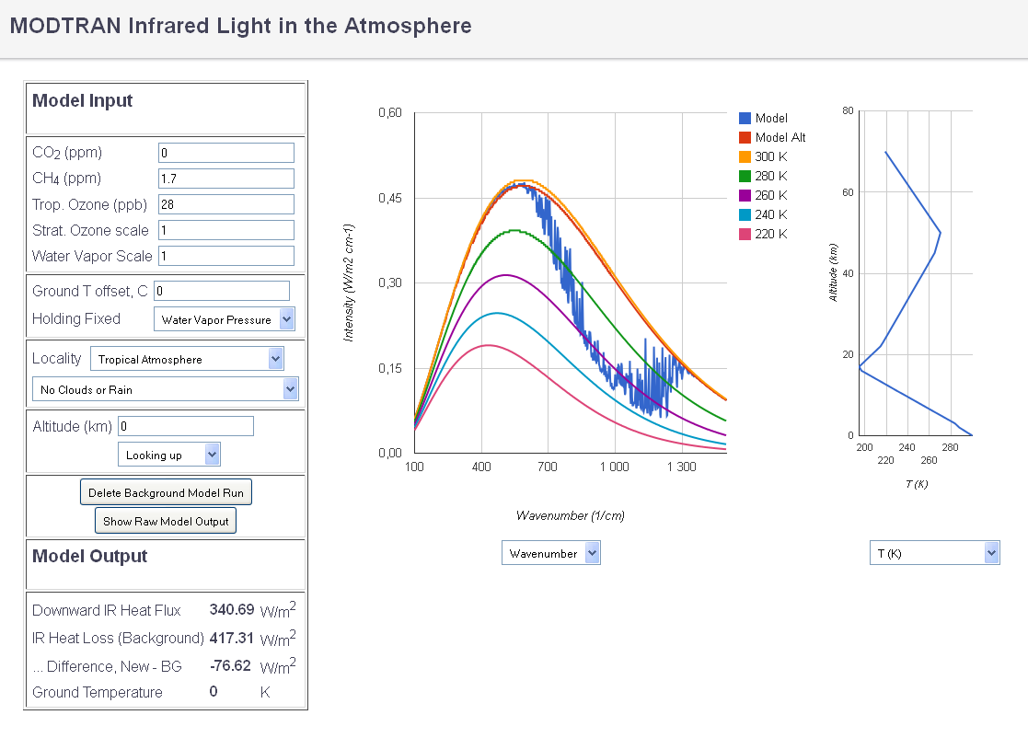
Then remove all the CO2, net loss 76.6

Slide 4
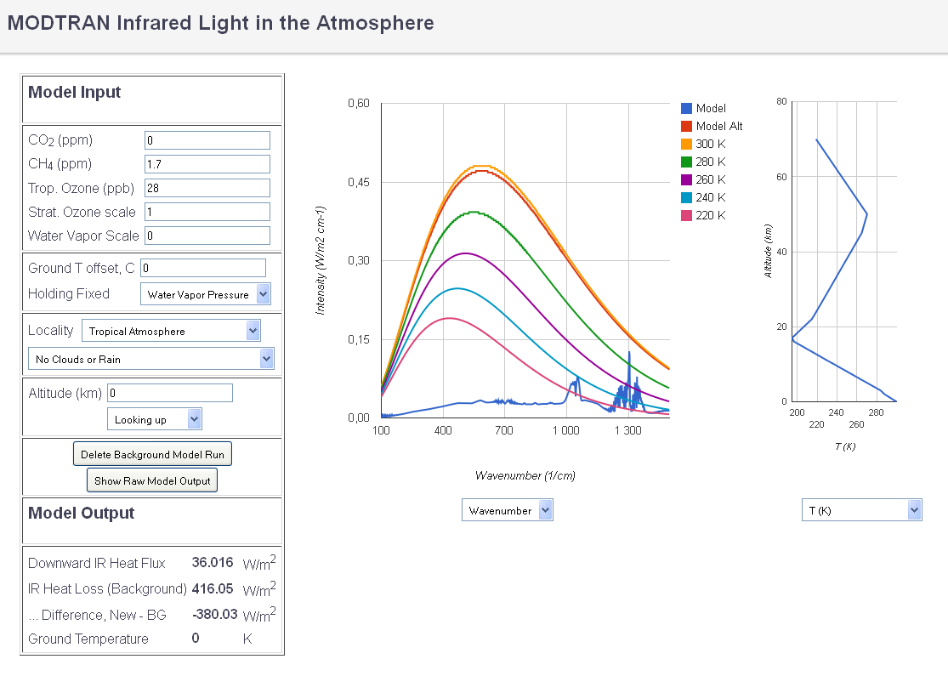
… and all the water vapor, net loss 380

Slide 5
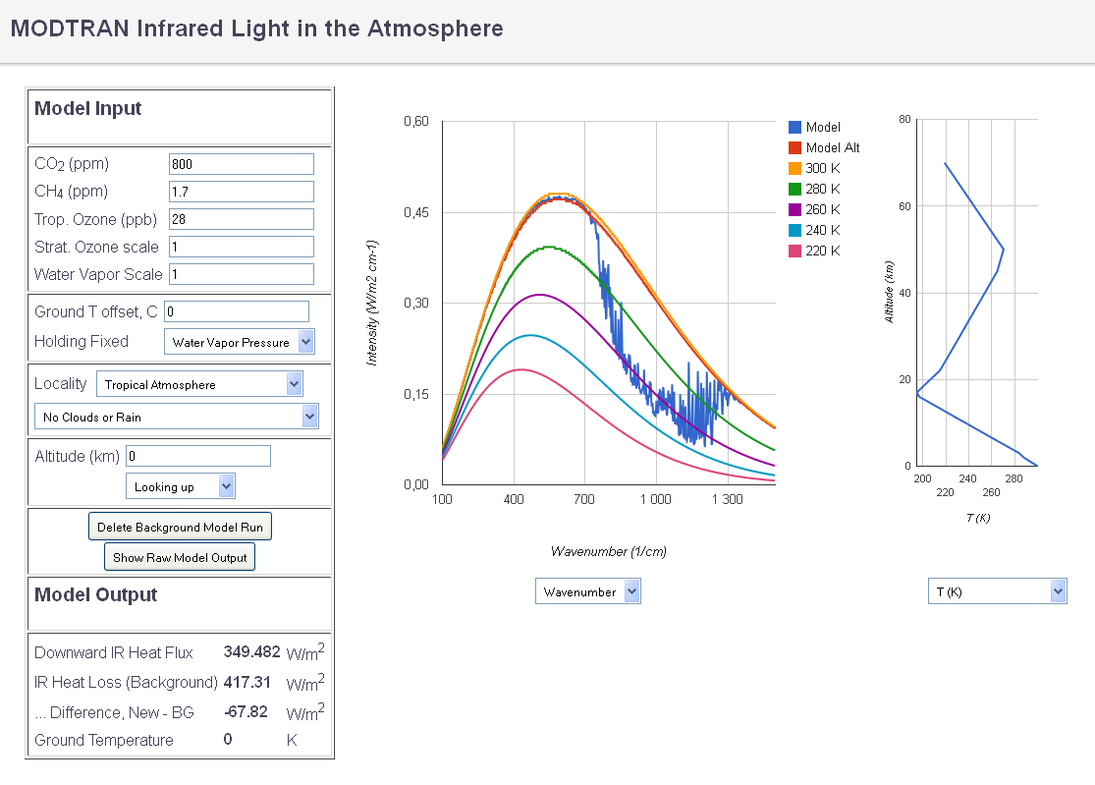
But doubling CO2 does not make much difference, net loss 67.8

Slide 6
Then we move to the ’Top of Atmosphere’, here at 70 km

Slide 7
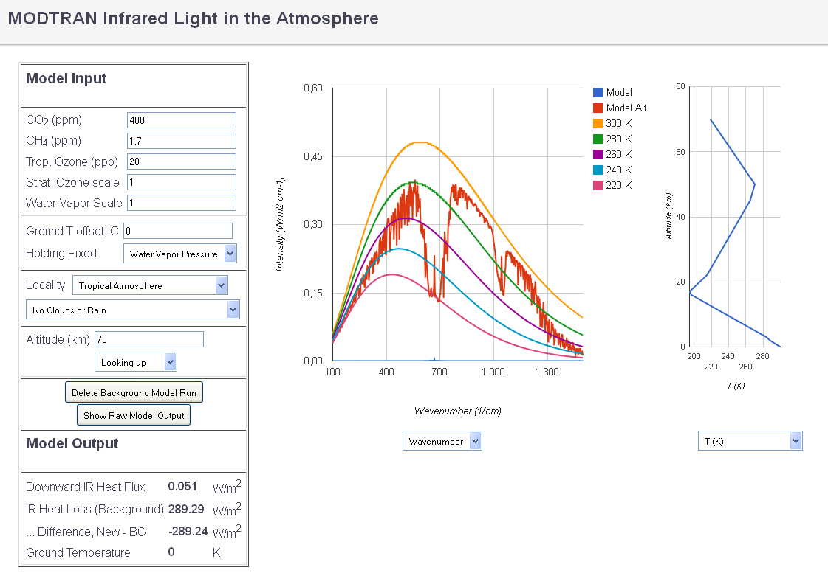
CO2 400 ppm

Slide 8
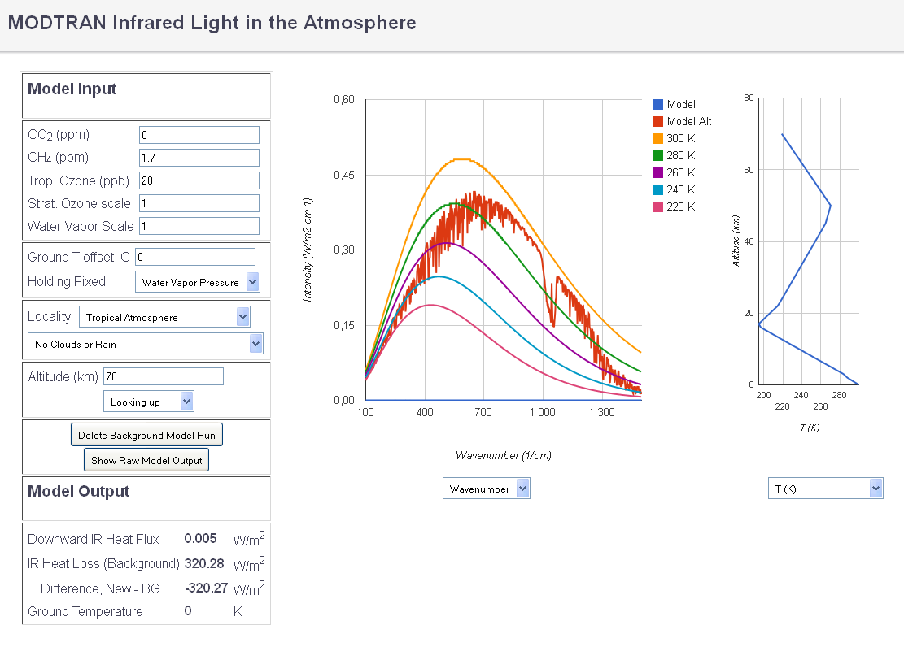
Then remove all the CO2

Slide 9
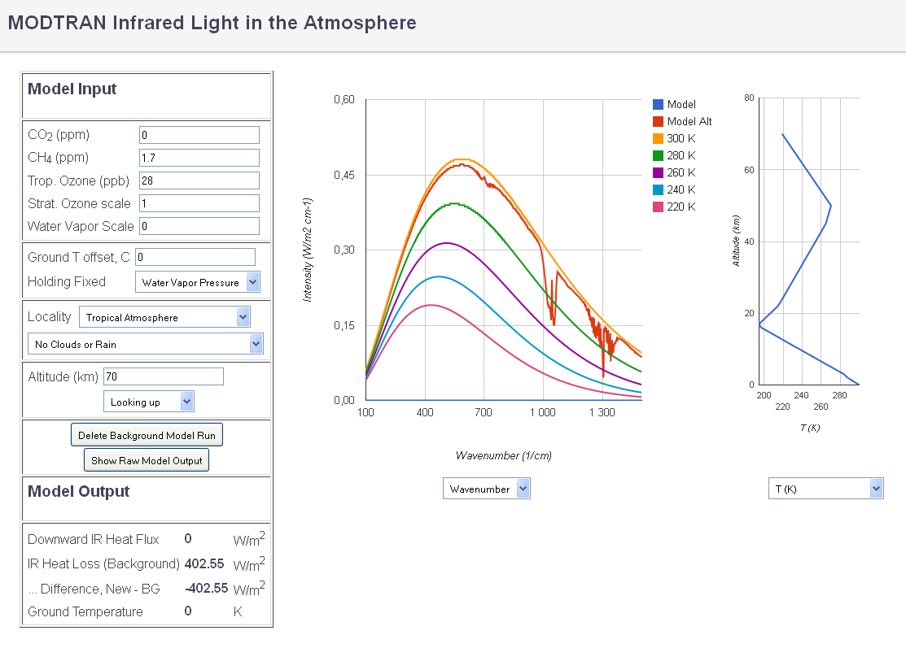
… and all the water vapor

Slide 10
But doubling CO2 does not make much difference

Slide 11
And a special gift for Tallbloke.
Adding a thick layer of clouds, up to 2.7 km
Removing all CO2 and vapor
As you can see that is basically lifting ’the surface’ to 2.7 km

Slide 12
